Slide 1
Unit 12
What did you do last weekend?
Section B 2a-2c
七年级下册

Slide 2

Objectives
To read and understand the passage about Lisa’s weekend
To learn to write about what you did last weekend

Slide 3
How can we have a great weekend?
Discussion

Slide 4
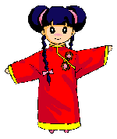
What kinds of animals are people sometimes afraid of? Why? Make a list.
2a
I think people are afraid of tigers, lions and snakes because they’re scary.

Slide 5

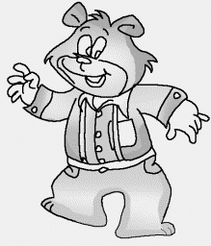
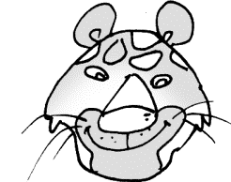
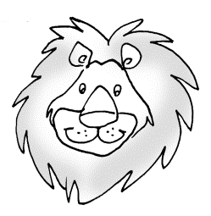
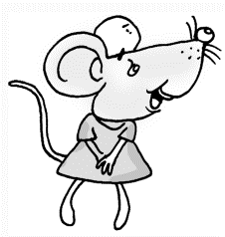
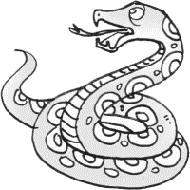
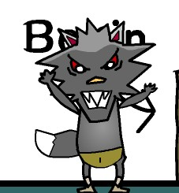
spider
bear
tigers
lions
mouse
snakes
wolf

Slide 6
Example:
I think spiders are scary_______ some of
them are poisonous.
2. Well, I think sharks are scary_______ they
can bite and kill people.
3. I think spiders are scary_______ they look
horrible.
because
because
because

Slide 7
2b. Read about Lisa’s weekend and
answer the questions.
1. How was Lisa’s last weekend?
2. Where did Lisa and her family go last
weekend?
3. How did Lisa feel when she saw the snake?
4. What did Lisa and her sister do?
5. What did their parents do?
Why did they do that?
6. What lesson did Lisa learn from the weekend?

Slide 8


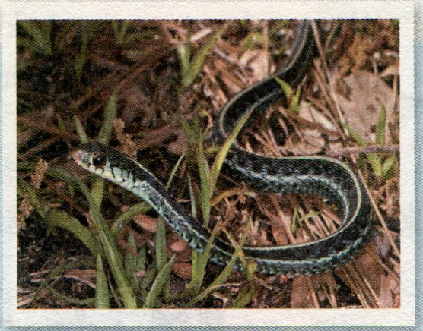
A Weekend to Remember
My sister finished high school
two weeks ago. As a special gift,
our parents took us to India. Last
weekend was interesting but scary.
We went camping in a small village
in India. First, we took a long bus ride to a lake in
the countryside. There we put up our tents and
made a fire to keep us warm and cook food on. On
the first night, we just sat under the moon and told
each other stories. But I was so tired that I went

Slide 9
to sleep early.
The next morning, my sister and I got a terrible
surprise. When we looked out of our tent, we saw
a big snake sleeping near the fire. I was so scared
that I couldn’t move. We shouted to our parents
to let them know about the danger. My dad started
to jump up and down in their tent. This woke the
snake up and it moved into the forest near the lake.
My dad told me later that snakes don’t have ears
but can feel things moving. He also told me it was
important not to go near a snake. This was a very
useful lesson for me.

Slide 10



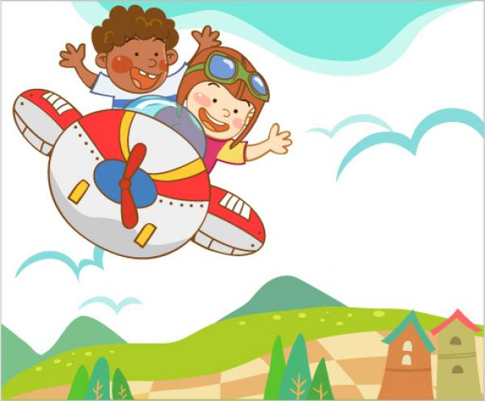
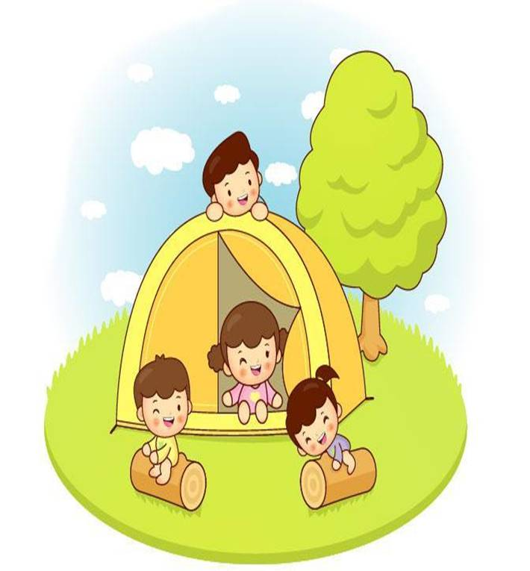

Read about Lisa’s weekend. Tick (√) the right pictures.
their air ride was short
went camping in a small village
made a fire to cook food

Slide 11

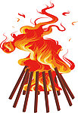
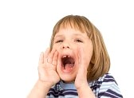
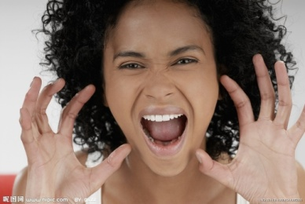
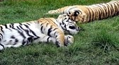
two tigers sleeping near the fire
shouted to their parents

Slide 12

Read the article again and answer the questions below.
1. How was Lisa’s weekend?
2. Where did Lisa and her family go last weekend?
3. How did Lisa feel when she saw the snake?

Slide 13
4. What did Lisa and her sister do?
5. What did their parents do? Why did they do that?
6. What lesson did Lisa learn from the weekend?

Slide 14
Answers:
1. It was interesting but scary.
2. They went to a small village in India.
3. She was so scared that she couldn’t move.
4. They shouted to their parents.
5. Her father jumped up and down to scare
the snake.
6. Don’t go near snakes./ Snakes can’t hear
but can feel movements.

Slide 15
2c. Put the phrases in order according
to the passage. Then use them to retell
the story.
____ snake went into the forest
____ put up our tents and cooked food
____ learned a useful lesson
____ saw a snake and shouted to parents for help
____ snakes can’t hear but can feel things moving
____ my dad jumped up and down in his tent
____ took a bus to a small village in India
____ told stories under the moon, then went to sleep
6
2
8
4
7
5
1
3

Slide 16
Language points
1. two weeks ago 两星期前，一段时间 + ago意为“多长时间之前”，是表达过去的时间。它常与一般过去时态连用。
三天前，我们参观了自然历史博物馆。
We visited the Natural History Museum
three days ago.
【辨析】before 意为“在……之前”，

Slide 17
其后可以跟一个时间的点；表示“在某 个时间点之前”，但不一定用于一般过去时态。例如：
我常在七点钟前去上学。
I usually go to school before seven.
此外，before也可以单独用，意为“以前”，可用于一般过去时态中。例如：

Slide 18
2. visit my sister 拜访我的姐姐
visit 参观(某地), 拜访(某人)
e.g. I visited the factory over the weekend.
在周末我去参观了这家工厂。

Slide 19
3. There we put up tents and made a fire to keep us warm and cook food on.
在那里我们架起帐篷，生火取暖并做饭。
注意固定搭配的用法：
put up tents 搭帐篷
made a fire 生火
keep us warm 取暖
cook food on fire 在火上做饭

Slide 20
4. But I was so tired that I went to sleep early.
但是我太累了，所以就早早睡了。
I was so scared that I couldn’t move.
我太害怕了，以至于一动都不敢动。
“ so+形容词+that 句子”，表示“太…以至于…”如：
The soup was so delicious that he drank it up.
这汤太美味了，以至于他喝了个精光。

Slide 21
5. wake up 唤醒; 后面可以跟名词或代词; 跟名词时可以放在wake up的后面或中间; 但是如果是跟代词的话应放于 wake up 的中间。如：
早上你常什么时候醒来？
When do you usually wake up?
不要如此大声说话，你会将他们吵醒。
Don’t speak so loud. You’ll wake them up.

Slide 22
6. see/watch/feel/hear sb. doing sth. 看到/观察到/觉得/听到某人在做某事
我们能听到水从山上流下来的声音。
We can hear water running from the mountain.

Slide 23

Ⅰ选词填空。
ago, tent, surprise, moon, scared, move, start, into
1. She went ____ the kitchen to cook some food.
2. The ______ circles (围绕) the earth every 28 days.
3. They came to visit China two days ____.
4. Do you know how to put up a ____?
into
moon
ago
tent

Slide 24
surprise
5. She got a great _________ when she got the Iphone 5.
6. My grandparents _______ to the countryside last year. They lived with my uncle in a village.
7. She _______ to learn English when she was ten.
8. She was really ______ to cross the rope way.
moved
started
scared

Slide 25
Ⅱ. 用所给动词的正确形式填空
is
1. Now he _____ (be) in Beijing. But last week
he _____ (be) in the USA.
2. Tina and Judy _____ (be) happy last weekend.
Now they _____ (be) at school.
3. She _____ (like) dogs very much. And she
gives it things to eat.
4. I _____ (do) my homework last Friday.
5. He often ________ (watch) TV at home.
Of course he ________ (watch) TV last night.
was
were
are
likes
did
watches
watched

Slide 26
Ⅲ. 单项选择
1. --What did they do over the weekend?
--They _________ to a movie.
A. went B. go C. gone
2. What ______ he _____ over the weekend?
A. do, did B. did, did C. did, do
3. --How ____ your weekend?
--Not too bad. I stayed home and watched TV.
A. was B. were C. is
A
C
A

Slide 27
4. I don’t have _____ bread, but I’d like ____.
A. any, few B. any, few C. any, a little
5. --Can’t you hear ______?
--No, I can hear _______.
A. anything, nothing B. anything, something
C. something, something
6. -- How _____ your weekend?
-- It ______ great. But I ______ tired (累)now.
A. was, was, am B. is, was, was
C. is, is, am D. is, is, was
C
A
A

Slide 28
7. --What did you do?
-- I __________.
A. play tennis B. played tennis
C. study science D. studying science
8. I think everyone _____ their weekends.
A. enjoy B. enjoys C. like D. liking
9. It is time ______ to school.
A. to go B. go C. goes D. went
B
B
A

Slide 29
D
10. Please don’t ______ your pencil in class.
A. play B. played
C. played with D. play with
11. --What is your father?
-- He’s a teacher. ______ your father?
A. How is B. Where is
C. What about D. What
12. Old Henry watched Wang _______
near his house.
A. walked B. walks C. walking D. walk
C
C

Slide 30
Homework
1. Write down the healthy and great
weekend you had.
(把你过得最好最健康的周末记录下来)
2. Make a plan for your coming weekend.
Let it be healthy!

Slide 31
Thank You!

